Slide 1
Arbitrage Bonds
Internal Revenue Code 148

Slide 2
Arbitrage Bonds
During issuance various determinations, covenants, and certifications are made regarding the tax-exempt status of bonds
These covenants and certifications to maintain tax-exempt status is over the life of the bonds.
Two sets of rules apply:
Yield restriction rules under IRC 148(a)
Rebate rules under IRC Section 148(f)
Notes:
If either of these rules are met the bonds are arbitrage bonds and will lose the tax exempt status.

Slide 3
Yield Restrictions
Yield Restriction Rules
Bond proceeds are invested at a materially higher yield than the bond yield
Exceptions for investing in the higher yield are not met
Yield reduction payments are not made to the US Treasury

Slide 4
Yield Restrictions
Materially higher yield than the bond yield is 1/8 of 1%
Proceeds from a 5% bond yield may be invested up to 5.125%
In the case of an advanced refunding it is 1/1000 of 1%
Yield reduction payments are made at the same time and manner as rebate payments using form 8038-T
Notes:
Although advanced refundings no longer qualify for tax-exempt status there could be previous issues outstanding.

Slide 5
Yield Restrictions
Investments of bond proceeds fall into three classifications
Class A – Purpose investments are subject to yield restrictions
Class B – Non-purpose investments are subject to yield restrictions after a temporary period
Class C – All other non-purpose investments are subject to arbitrage rebate requirements
Notes:
Purpose investments are acquired for the purpose of the issue. An example would be providing loans to not-for-profits. The loan would be considered and investment of the proceeds.
Non-purpose are not for the government purpose of the issue. Most common and would be investing the proceeds of construction bonds during the construction period.
All other example would be investments for a reasonably required reserve fund.

Slide 6
Yield Restrictions
Exceptions to the yield requirements
Held during a temporary period
Held in a reasonably required reserve or replacement fund
Represents a minor portion
Even if these exceptions are met the rebate requirements still apply
Notes:
The minor portion applies to the lesser of $100,000 or 5% of the sale proceeds.
Reasonably required reserve or replacement fund cannot exceed the lessor of 10% of the principal amount of the issue
Maximum annual debt service on the bonds
125% of the average annual debt service on the bonds

Slide 7
Yield Restrictions
Temporary period depends on the purpose of the bonds and investment
Bonds for acquisition or construction of a governmental capital asset is 3years
May be extended to 5 years
For the 3-year temporary period to apply the issuer must reasonably expect at the time of issuance that
85% of the bonds net proceeds will be expended for the capital project within 3 years
Within 6 months of issuance have a binding obligation to a third party to allocate at least 5% for the capital project
Proceed with due diligence to complete the project
Notes:
5 year extension requires the certification of the issuer and licensed architect or engineer that the project will take more than 3 years

Slide 8
Yield Restrictions
Other temporary periods
13-month temporary period for debt service and working capital
1-year temporary period for investment proceeds
Begins when the proceeds are received
90-day temporary period for current refundings
All other proceeds have a 30-day temporary period
Notes:
Working capital is for operational type expenditures
Investment proceeds is the interest earned on investing the bond proceeds
Most temporary periods begin on the issuance date.

Slide 9
Rebate Rules
Certain arbitrage earnings must be paid or rebated even if the issuer is allowed to invest in higher yielding investments under the yield restriction rules
Rebate rule exceptions are based on
How quickly the proceeds are used
Type of bonds
Size of the issuer
Category of proceeds invested
Purposes and uses
Notes:
Working capital is for operational type expenditures
Investment proceeds is the interest earned on investing the bond proceeds
Most temporary periods begin on the issuance date.

Slide 10
Rebate Rules
Spending exceptions
6 months
18 months
2 years
Special Exceptions
Small issuer
Bona fide debt service fund
Notes:
Bona fide debt service fund is established to hold revenue or other monies to pay upcoming debt service and generally must be depleted at least once each bond year to qualify as a bona fide debt service fund.

Slide 11
Rebate Rules
6-month spending exceptions
Gross proceeds must be expended for the governmental purpose of the bonds within 6 months
The following are excluded from gross proceeds for this exception
Proceeds held in a bona fide debt service fund
Proceeds derived from a purpose investment
The issuer meets the rebate requirements for the issue proceeds not covered by the 6-month exception

Slide 12
Rebate Rules
18-month spending exceptions
Gross proceeds must be expended for the governmental purpose of the bonds under the following schedule:
15% of the proceeds allocated in 6 months
60% within 12 months
100% within 18 months
The issuer must meet the rebate requirements for all proceeds not required to be spent in the 18-month period
The bond gross proceeds must also qualify for the 3-year temporary period under the yield restriction requirements
Notes:
A limited amount of unspent proceeds may be retained for reasonable retainage.
The retainage must be allocated within 30 months of the issue date and may be disregarded if
The issuer exercised due diligence to complete the project
The amount of proceeds that does not meet the schedule is the lesser of 3% of the bond issue price or $250,000

Slide 13
Rebate Rules
2-year spending exceptions
Applies only to non-refunding construction issues
To qualify the issuer must reasonably expect as of the issue date that 75% of the construction proceeds will be allocated to construction expenditures
Proceeds must be spent according to the following schedule
10% within 6 months
45% within 1 year
75% within 18 months
100% within 2 years
An issuer of a construction issue may elect by the issue date to pay a “penalty in lieu or rebate”
Notes:
A limited amount of unspent proceeds may be retained for reasonable retainage.
The retainage must be allocated within 3 years of the issue date and may be disregarded if
The issuer exercised due diligence to complete the project
The amount of proceeds that does not meet the schedule is the lesser of 3% of the bond issue price or $250,000

Slide 14
Rebate Rules
Special Exceptions
Small Issuer
Not expected to issue tax-exempt government bonds in excess of $5million in a calendar year. $15million for construction of public-school facilities.
The governmental unit issuing the bonds has general taxing powers
95% or more of proceeds will be used for the issuer’s local government activities
The issuer may not try to avoid the $5million limitation
Notes:
The issuer must include the following bonds when determining the $5m limitation
Entity (other than the political subdivision) tat issues bonds on behalf of the issuer
Subordinate entity directly or indirectly controlled by the issuer
Bonds issued by an entity formed to avoid the limitation

Slide 15
Rebate Rules
Special Exceptions
Bona fide debt service fund if either of the following are met
The gross earnings are less than $100,000. This requirement is met if the issue has an annual debt service not greater than $2.5million.
The issue is governmental bonds, has an average maturity of at least 5 years, and the bonds bear interest at a fixed rate.

Slide 16
Rebate Amounts & Payments
Generally, must be computed and paid once every 5 years over the life of the bonds
The date of the computation is flexible except for the final which must be done the date the bond is fully discharged
Rebates must generally be paid within 60 days of the computation date
Except for the final calculation, an issuer may pay at least 90%
100% of the amount is due with the final calculation
Notes:
Amount due is less what has been paid previously.

Slide 17
Rebate Amounts & Payments
The computation is the difference between
The investment yield earned on non-purpose investments and
The amount these would have earned if invested at the bond yield
The investment purchases and receipts are future valued to a single date
Each computation date is a snapshot of actual and allowable earnings as of that date over the life of the bonds

Slide 18
Rebate Amounts & Payments
Past receipts and payments are future valued at the bond yield using the same compounding interval and financial conventions used to compute the yield on the issue.
The rebate amount is the difference between the value of receipts and payments as of the computation date.
Any previous rebate payments made are also future valued to the computation date.

Slide 19
Rebate Amounts & Payments
The following payments are considered
Yield reduction payments
Purchase of an investment
A credit on the last day of each bond year
Value of a previously acquired investments that becomes allocated to the issue

Slide 20
Rebate Amounts & Payments
The following receipts are included
Earnings and return of principal from non-purpose investments
Value of non-purpose investments no longer allocated to the issue or subject to the rebate requirement before the disposition and redemption date.
Value of non-purpose investments held at the end of the computation period.

Slide 21
Example Calculation
$49 million gross proceeds variable bonds issued January 1 2025
First interim calculation due January 1, 2030
Bond yield for first computation is 7%
On issue date purchased $41 million in US Treasury Notes with annual coupon of 7.53%
$8 million on issue date to purchase US Treasury money fund at 4.97% annual interest rate

Slide 22

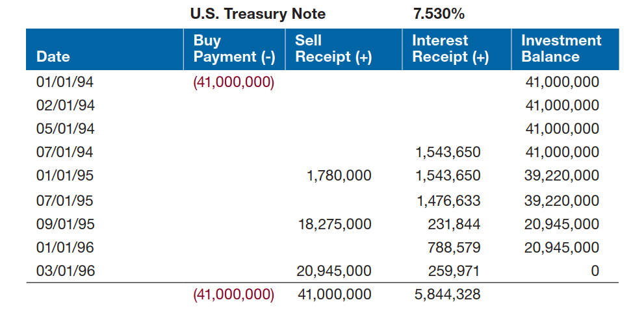
Example Calculation
In this example payments are negative, and receipts are positive

Slide 23
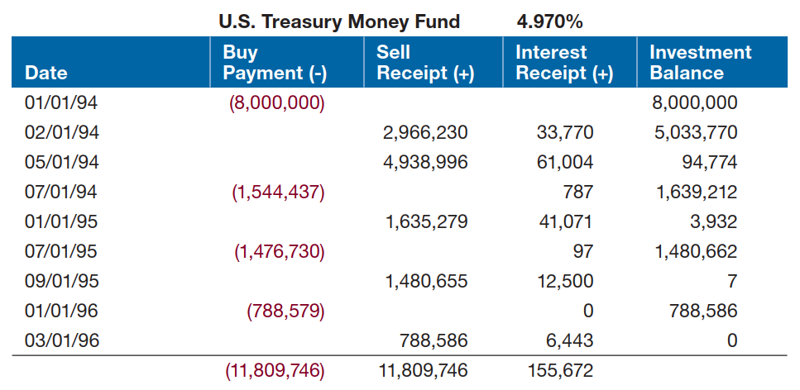
Example Calculation

Slide 24
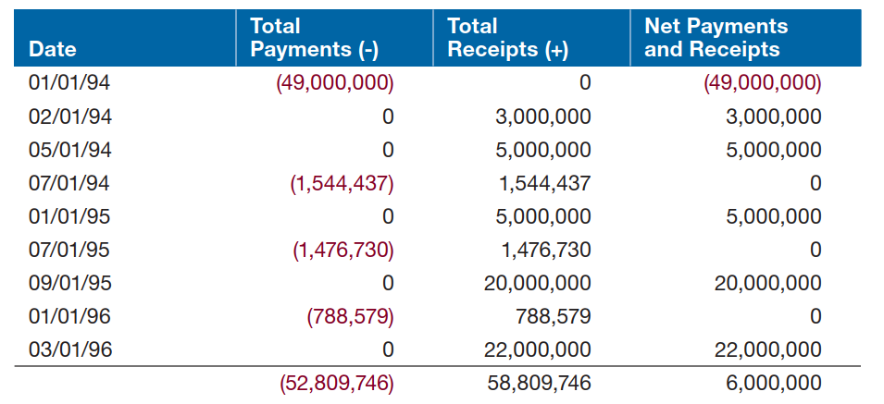
Example Calculation
Net payments and receipts for both investments

Slide 25
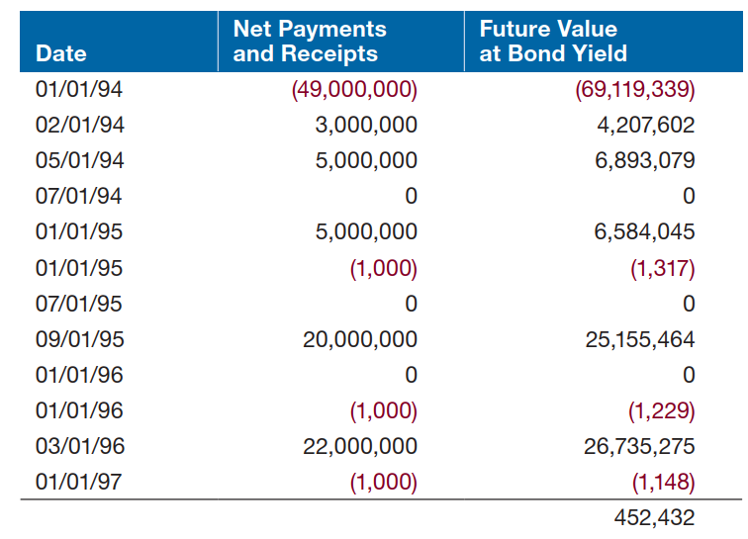
Example Calculation

