Slide 1
2025 Advanced Accounting Seminar Audit Preparation How to Make Your Audit Go Seamlessly
Ashley Perry, Center for Audit Excellence

Slide 2

How do you feel about your Audit?
Frustrated?
Stressed?
Confused?
Worried?
Overwhelmed?
Frazzled?
Notes:
Being informed, prepared, and organized for your audit is the best way to combat feeling negative about your audit.
At the end of this webinar, I will ask you this question again, My hope is that your answer has improved – even if just slightly.

Slide 3

Agenda
What is an audit?
Important deadlines
Resources available on AOS webpage
Tips for an efficient audit
Notes:
.

Slide 4
“Audit” Types
Basic Audit (Basic)
Agreed-Upon Procedures (AUP)
GAGAS Financial Statement Audit
ORC 117.11(B) Public Interest Audits
Single Audits (Federal $)
Notes:
Basic = eligibility, not limited in # of times, high level review procedures, on-site a few hours
- Large savings on full audit costs, depending on the entity type and services provided by the entity.
- To qualify, entities must meet certain criteria, for example the following are considered in the determination: • Have total disbursements of $600,000 or less over 2-year period (or $300,000 if 1 year audit) • Be reconciled and auditable • Not be required to file GAAP • Not be required to have an audit for federal funding and/or debt covenant purposes or a component Unit
AUP = must meet eligibility, only allowed 3 in a row then full GAGAS audit
- AUPs narrow the scope of work to reviewing key internal controls and performing targeted testing of significant transactions.
- While not as large as basic, still a large savings when compared to the cost of a full audit, depending on the entity type and services provided by the entity.
- To qualify, entities must meet certain criteria, for example the following are considered in the determination: • Have budgeted expenditures of less than $5 million annually • Be reconciled and are auditable • Have a history of clean audits • Not be required to file GAAP • Have limited Fiscal Officer turnover • Have audit fess paid in full • Not be required to have an audit for federal funding and/or debt covenant purposes or a component unit
GAGAS = regular f/s audit – planning, controls, substantive, compliance, opinion on f/s. The bulk of the presentation will focus on this type.
Section 117.11 | Annual, biennial, and early audits.
- (B) In addition to the annual or biennial audit provided for in division (A) of this section, the auditor of state may conduct an audit of a public office at any time when so requested by the public office or upon the auditor of state's own initiative if the auditor of state has reasonable cause to believe that an additional audit is in the public interest. 117 public interest audit.
- for example: Unemployment Audit
Single Audits – Audits of federal programs – is added onto regular financial statement audits.
- You would only be required to have a single audit if you expend at least $750,000 in federal monies during the fiscal year (increasing to $1 million for fiscal periods beginning on or after 10/1/24).
- Will discuss more later. There is another presentation at 1:15 today that takes a deep dive into Preparing for a Single Audit. My presentation only has a few slides on that topic, so consider attending that session if you need more info.

Slide 5
What is an Audit and Why do I Have to Have one?
An Audit is...
Evaluation of the Financial Statements
Evaluation of Internal Control and Compliance
Purpose of an Audit…
Gain Assurance over Financial Statements
Add Credibility to Financial Statements
Express an Independent Opinion
Notes:
For slide: There are a lot of definitions regarding what the term “audit” means.
Basically an “Audit” is an objective examination and evaluation of the financial statements of an entity to make sure that the records are a fair and accurate representation of the transactions they claim to represent. Audits of government entities in the state of Ohio not only look at the financial statement information but also evaluate internal controls and compliance with various laws.
The purpose of the audit is to lend credibility to the financial statements by expressing an independent opinion after gaining assurance over management's assertions as they relate to the financial statements.

Slide 6
Audit Frequency
Ohio Law- biennial
Federal Single Audit - $750,000* in Federal Expenditures
Anytime – Public Office Request or AOS Initiative
Notes:
For slide:
-Ohio Revised Code Section 117.11(A) states except as otherwise provided, the auditor of state shall audit each public office at least once every two fiscal years.
-This section also states that the auditor of state shall audit a public office each fiscal year if that public office is required to be audited on an annual basis pursuant to "The Single Audit Act of 1984." Meaning that the entity has expenditures at least $750,000 in federal monies during the fiscal year. As I mentioned earlier, this threshold is increasing to $1 million for fiscal periods beginning on or after 10/1/24.
-Finally, Ohio Revised Code Section 117.11(B) states that in addition to the annual or biennial audit, the auditor of state may conduct an audit of a public office at any time when so requested by the public office or upon the auditor of state's own initiative if the auditor of state has reasonable cause to believe that an additional audit is in the public interest. -117 audit per slide 4

Slide 7
Audits vs. Filing
ORC 117.11 requires at least biennial audits
However, you must annually file financial statements, notes, etc. via Hinkle system
Notes:
Stress the importance of annual Hinkle filing.

Slide 8
Who Will be Doing the Audit?
Auditor of State
Independent Public Accountant
Notes:
For slide: The Auditor of State is the constitutional officer responsible to audit about 6,000 local governments, state agencies, boards & commissions, including colleges and universities.
Audits are completed by both the Ohio Auditor of State and Independent Public Accounting firms.
Ohio Revised Code Section 117.11(C)(1) and (2) allows the legislative authority or governing board to engage an independent certified public accountant to conduct an audit within certain guidelines and regulations.
In addition, the Auditor of State may also choose to have an IPA audit an entity in cases where there may be conflicts of interest or the audit is not going to be completed in a timely manner due to the amount of work and man hours available and needed.
So entities or AOS may request audits be completed by the IPA as opposed the Auditor of States office. If they do, they need to follow ORC Section 117.11(C)(3).
Ohio Revised Code Section 117.11(C)(3) states that the auditor of state shall approve the scope of an audit under division (C)(1) or (2) of this section as set forth in the contract for the proposed audit before the contract is executed on behalf of the public office that is to be audited. The independent accountant conducting an audit under division (C)(1) or (2) of this section shall be paid by the public office.
AOS Region facilitates the bidding/contract process
AOS CFAE Quality Assurance reviews audit reports prepared by IPA firms before release to the public
AOS Regions are involved in IPA audits when significant audit issues arise

Slide 9
Auditor Letters
Independent Auditor’s Report
Opinion on fair presentation of financial statements
GAGAS Letter
Generally Accepted Government Auditing Standards
Single Audit Letter
Opinion on compliance for each major program
Results of tests of internal controls and compliance
Financial statement impact
Results of tests of internal controls and compliance
Federal program impact
Opinion on Schedule of Expenditures of Federal Awards (if applicable)
Management Letter
Communicates control deficiencies and non-compliance with a less-than-material effect on the financial statements or other issues with significance to the audit objectives
Are not included in the audit report, or on AOS website
Notes:
Your auditors may issue up to 4 letters

Slide 10
Terminology
Noncompliance
Citation
Recommendation
Internal Control Deficiency
Notes:
Now that you understand the different types of letters you might receive, next we’re going to cover the different types of audit comments, and where you would find them – but first……

Slide 11
Types of Audit Comments
Verbal
Management Letter
Report Level
Notes:
For slide: The next couple slides explain the different types of audit comments – verbal, ML, report level.
There are standards that guide auditors to determine the appropriate level a comment should be at.

Slide 12
Types of Audit Comments
Report Level
GAGAS (Section 2)
Other – FFR (Section 4)
Single Audit (Section 3)
Noncompliance
Internal Control: Material Weakness or Significant Deficiency
Noncompliance
Internal Control: Material Weakness or Significant Deficiency
Notes:
.

Slide 13
Types of Audit Comments
Management Letter or Verbal
Noncompliance
Recommendation
Notes:
Management Letter
Communicate control deficiencies and non-compliance with a less-than-material effect on the financial statements or other issues with significance to the audit objectives.
As mentioned earlier, ML’s are not included in the audit report or on the AOS website.
Verbal Comments
Address control deficiencies or non-compliance with laws or regulations that have an insignificant or immaterial effect, or errors with an immaterial effect on the financial statements.
These issues are informally communicated to management.

Slide 14

is an Audit Important?
Fulfill your fiduciary responsibility
Obtain assurance related to the financial integrity of funded programs
Identify possible non-compliance and other issues early, to avoid interruption of current funding
Lower the risk of future non-compliance
Build goodwill among taxpayers
Strengthen your ability to secure additional funding in the future.
Source: https://www.aicpa.org/interestareas/governmentalauditquality/resources/auditeeresourcecenter/whyauditqualityisimportantforauditees.html
Notes:
.

Slide 15
Tips For An Efficient Audit
Notes:
.

Slide 16

What can I do to keep audit costs low?
Complete, organized, and easily accessible records
Stay ahead of routine responsibilities
Be aware of special circumstances and be knowledgeable about potential compliance and accounting impact
Improve internal controls
Keep up with monthly bank to book reconciliations
Ensure relevant personnel will be available during the course of the audit
Notes:
After last bullet point give examples of ‘relevant personnel’.
People-F/o, Payroll , a/p, federal grants, etc

Slide 17
Tips for an Efficient Audit
Reconcile
File Annual Report
Maintain Public Records
Notes:
For slide:
At the end of each fiscal year, the Fiscal Officer should complete the final monthly reconciliation and then prepare the entities Year End Financial report.
Once the report is prepared, the financial statements, notes to the financial statements, (and optional MD&A & any supplementary information) should be filed in the Hinkle Filing System using the link provided by the Auditor of State’s Office.
It is important to maintain a copy of the report for your records and to ensure that the financial statements and other documents are supported by original documentation.
Once the report has been filed, all records for the fiscal year should be maintained in a neat and orderly fashion so they are ready when the auditors reach out.

Slide 18
Tips for an Efficient Audit
Good communication with auditors before planned start date that auditors will arrive.
Provide information in an electronic format / ledgers in excel for sorting, searching, etc.
Will personnel be available for audit inquiries (vacations, etc.)?
Provide auditors with a list of who the ‘go-to’ person is for each area (to make inquiries/obtain documents).
If there is going to be a significant delay in getting records to the auditor, make them aware.
Notes:
After 2nd item - Electronic format - Allows for greater efficiencies in sharing information amongst audit staff & allows for work to be completed off-site.
After 4th item – It is so very important to provide your auditor’s with a go-to person, and when that person may not be available. This way the auditor can plan their testing around that schedule.

Slide 19
Tips for an Efficient Audit
Discuss items auditors could gather ahead of starting the audit
Minutes if accessible via the government’s website, records on UAN, etc.
Location(s) auditors will perform audit work
Client Location
Regional Office
Telework / Remote Work Location / Another audit site
Information needed for connectivity to internet at the client location
Notes:
2nd item – client location – it is also helpful for auditors to know the size of a room/table that they will be working in. This can help with coordinating with other team member in the event the area is smaller and only one or two people can comfortably be there.

Slide 20
Tips for an Efficient Audit
Communicate with your auditors before audit is started. Types of questions auditors may ask:
Significant financial transactions incurred
Compliance with requirements outlined in Ohio and Federal Compliance Supplements
Internal controls, and any changes made
Changes in significant personnel
Status of audit comments from the prior audit
Notes:
.

Slide 21
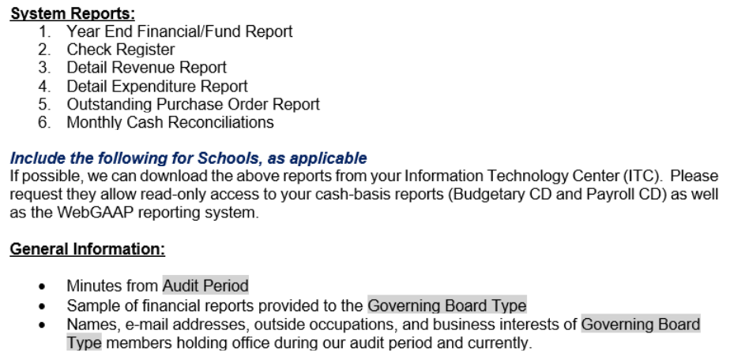
Tips for an Efficient Audit
Often auditors will provide an initial audit documentation request list – be sure to have the documents pulled and ready in a timely manner. For example:
Notes:
The next few slides include example lists. The list provided by your auditors will not be all inclusive and additional documentation may be requested throughout the audit process.
You should make every attempt to minimize or eliminate the transmission of personal information to your auditors.

Slide 22
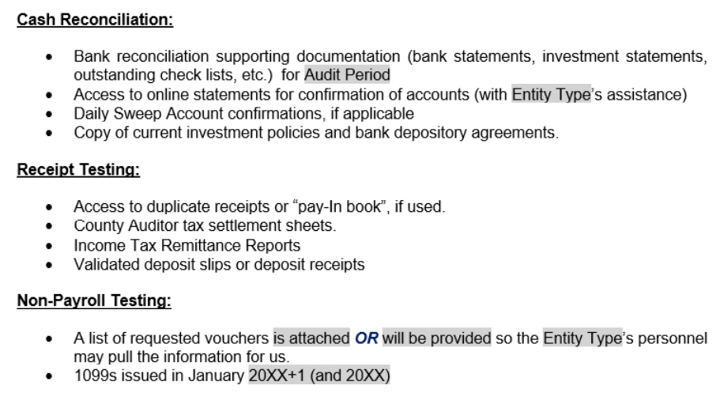
Tips for an Efficient Audit
Notes:
Also need bank statements/reconciliations for the first few months after the audit fye to check if outstanding items have cleared (checks, deposits in transit, etc.)

Slide 23
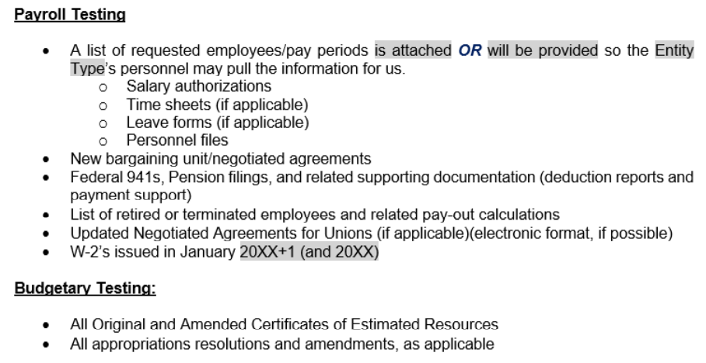
Tips for an Efficient Audit
Notes:
.

Slide 24
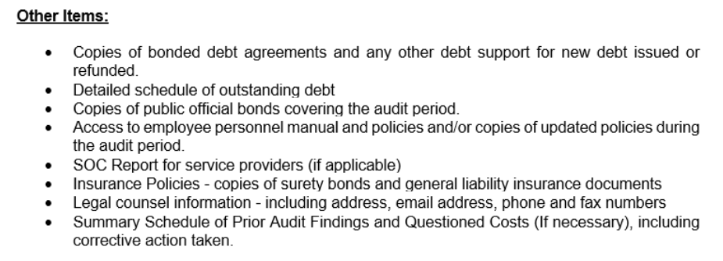
Tips for an Efficient Audit
Notes:
.

Slide 25
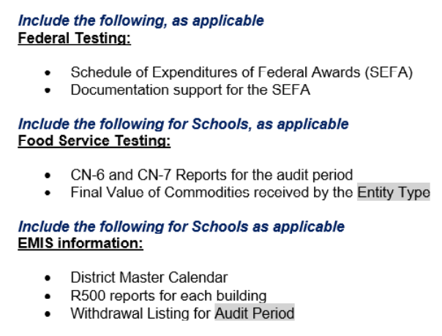
Tips for an Efficient Audit
Notes:
.

Slide 26
Tips for an Efficient Audit
Understand compliance requirements (federal, state, etc.)
Gather and provide documentation to show that your entity is in compliance with applicable requirements
Ohio Compliance Supplement (OCS) https://ohioauditor.gov/references/compliancemanuals.html
Federal (OMB) Compliance Supplement - https://www.fac.gov/compliance/
Federal Award Compliance Control Records (FACCR) - https://ohioauditor.gov/references/practiceaids/faccrs.html
Good communication between the Fiscal Officer & auditors on the estimated date in which the report will be completed and filed with AOS
Notes:
The OCS will be explained further on the next few slides.

Slide 27
What Will the Auditors Look At?
Nothing is off the table
What the auditors plan to look at the start of the audit may change
We follow the evidence
No one size fits all audit
Be prepared for the auditors to look at everything
Depends on the entity, the reporting basis, the activity, etc.

Slide 28

What Will the Auditors Look At?
Audit Sampling is an audit testing method where less than 100% of the total items within the population or account balance are selected to be reviewed
Non-payroll for selected expenditures
Invoices
Purchase Orders
Payroll Items for selected employees
Time Sheets
Employment Contracts
Leave Records
Auditors will provide you with a list of items selected for review in the Audit Sample.
Examples of an audit sample request:
Checks
Notes:
.

Slide 29
Important Deadlines
Notes:
.

Slide 30
Important Deadlines
Financial Statement Filing Requirements
Single Audit Deadline
Other Regulator Deadlines
Service Organization Control Reports (SOC 1 Reports)
GFOA Deadlines
Notes:
Will go over each of these in detail on the following slides.

Slide 31
Ohio Administrative Code Financial Statement Basis
Financial Statement Filing Requirements (OAC 117-2-03(B) and (C)
GAAP
Special Purpose Framework
Counties
Cities
Schools, including ESCs and Comm Schools
Government Insurance Pools (some)
All Others
Notes:
Ohio Admin. Code 117-2-03(B) requires counties, cities, and school districts, including educational service centers and community schools, and some government insurance pools to report annually (but not necessarily account) on a GAAP basis.
All other entity types are not required to file on a GAAP basis and may file using a Special Purpose Framework such as Other Comprehensive Basis of Accounting (referred to as OCBOA) or regulatory basis. ‘Special Purpose Framework’ will be explained on the next slide.
Townships/Villages/Libraries would typically fall into the Special Purpose Framework category. However, there is an exception as you will see on the next slide.

Slide 32
Required Financial Statement Elements
GAAP
MD&A
Basic Financial Statements
Required Supplementary Information
Cash / Modified Cash
Notes to Basic Financial Statements
AOS Regulatory Basis
Statement of Cash Receipts, Cash Disbursements, and Changes in Fund Balances
Government-Wide and Fund Financial Statements
Notes to the Basic Financial Statements
Notes to the Basic Financial Statements
MD&A and other supplemental information are optional
https://ohioauditor.gov/references/shells.html
Notes:
.

Slide 33
Uniform Guidance / Single Audit Financial Statement Basis
2 CFR 200.514(b)
Requires auditors to determine whether the financial statements of the auditee are presented fairly in all material respects in accordance with GAAP.
Therefore, auditees required to have a single audit (federal) are required for file on a GAAP basis of accounting regardless of OAC requirements.
Notes:
Financial statements. The auditor must determine whether the auditee's financial statements are presented fairly in all material respects in accordance with generally accepted accounting principles (or a special purpose framework such as cash, modified cash, or regulatory as required by State law). The auditor must also determine whether the schedule of expenditures of Federal awards is stated fairly in all material respects in relation to the auditee's financial statements as a whole.
[OCBOA and/or Regulatory basis of accounting are not required by Ohio law]
https://www.ecfr.gov/current/title-2/subtitle-A/chapter-II/part-200/subpart-F
While this basis is required for those having a single audit, some entities do not feel it is worth the cost to file on a GAAP basis. If you do not file on the appropriate basis you will receive a reportable citation and will not be a low-risk auditee. The not-low-risk designation results in auditors having to test more of your federal expenditures.
The filing status is not the only criteria for determining if your Government is a low-risk entity for federal testing purposes.

Slide 34
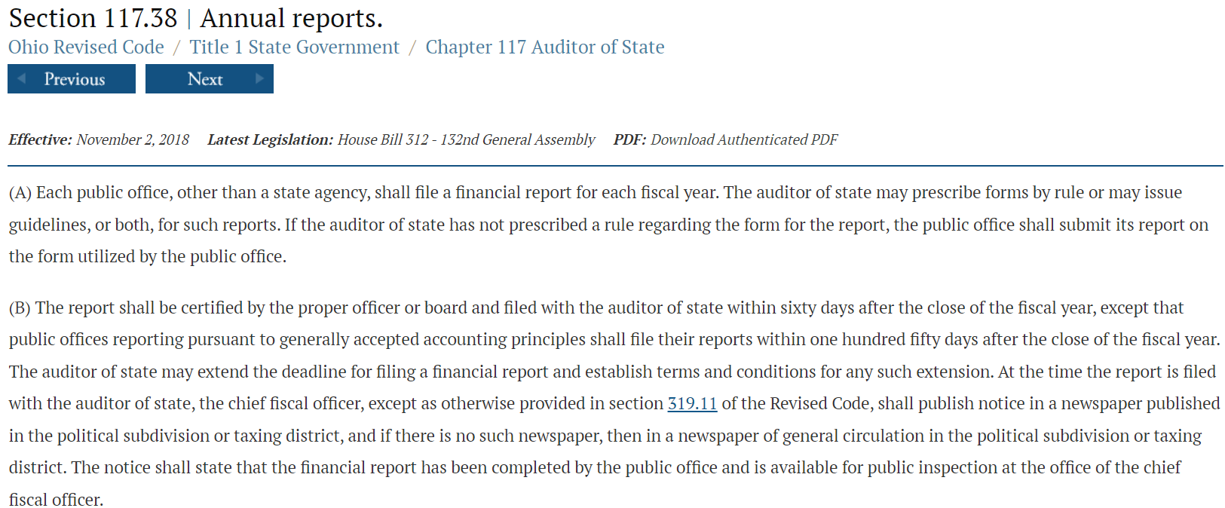
Financial Statement Filing Requirements
Ohio Rev. Code § 117.38 (ORC) requires that local public offices file their annual financial reports with the Auditor of State (AOS).
Entities filing on a GAAP basis have 150 days following the end of the fiscal year to submit their financial reports to the AOS.
Other entities required to file and GAAP-mandated entities choosing to not file on a GAAP basis, have 60 days following fiscal year-end to complete their submission to AOS.
Notes:
CIC’s, DC’s, colleges have 120 days to file gaap f/s-but most have the 150-day requirement

Slide 35

Hinkle Annual Financial Data Reporting System
Internet‐
based application
Mandatory method for filing
Filing link available through eservices
AOS Bulletin 2015-007
OCS 1-14
https://ohioauditor.gov/financialreporting/default.html
Notes:
Internet‐based application
Mandatory method for filing
Filing link available through eservices*
The Hinkle System e-mail directs you to log into your eServices account to access the link. In addition, the entity’s ‘Bill To’ (main) or Hinkle System Reporting contact can click the ‘Share Link’ to e-mail the link, if necessary.
Further information is available in AOS Bulletin 2015-007 & OCS 1-14

Slide 36
Single Audit (federal) Deadline
September 30 is deadline for 12/31 fiscal year end clients
March 31 for 6/30 fiscal year end clients
Must file audit report with the Federal Audit Clearinghouse (FAC)
FAC distributes single audit reporting packages to federal agencies
Database of completed audits
Filing Requirement Not Met = Not Low Risk Auditee
Additional audit testing required for subsequent two audits = increased audit cost
Notes:
Side note – there are a few entities that have had Alternative Compliance Examination engagements (ACE) that we’ll discuss later – those are filed through Treasury’s website.
Again, as mentioned on slide 5 – you would only be required to have a single audit if you expend at least $750,000 in federal monies during the fiscal year (and soon to be $1 million).

Slide 37
Single Audit Reporting Items
Schedule of Expenditures of Federal Awards (SEFA)
Notes
to the
SEFA
Data
Collection
Form
(DCF)
https://ohioauditor.gov/references/practiceaids.html
Notes:
For slide: We’re going to spend a few min’s on single audit items. As mentioned earlier my presentation only has a few slides on Single Audit, so if you need more info, consider attending the 1:15 session on Preparing for a Single Audit.
These items are in addition to your regular financial reporting when you are subject to a single audit
SEFA and Notes to the SEFA are prepared by the government or their converter
Certain parts of the DCF are done by the client and other parts are done by the auditor
AOS provides templates on our website. These templates are written to meet standards and include instructions and footnote guidance.

Slide 38
Schedule of Expenditures of Federal Awards (SEFA)
List individual Federal programs by agency.
Total amount paid to subrecipients must be listed.
COVID Funding must be identified separately.
Federal non-cash expenditures and cash expenditures are included for the year.
Clusters must list Cluster and individual program names.
Pass-through entity and identifying number assigned by the pass-through entity must be included.
Notes:
Before list: 2 CFR 200.502 and 200.510 dictate requirements for the SEFAs, in addition to the AICPA Single Audit Guide.
Noncash expenditures are items received by the government that are of value but are not in the form of cash, They may include items such as donated property or free rent

Slide 39
Important Notes!!
Uniform Guidance requires the government to prepare a schedule of expenditures of federal awards (SEFA).
Auditing standards require the auditor to determine and provide an “in relation to” opinion on, whether the auditee’s schedule is fairly stated, in all material respects, in relation to the basic financial statements taken as a whole.
Auditors must be able to audit original records.
Auditing standards require the auditor to provide an opinion on, each Major Federal Program Compliance Requirement.
Notes:
Some Fiscal Officers assume that the federal schedule is the auditors responsibility to prepare – that is not true!
So, how do you know if you require a single audit, if you don’t track and calculate total federal expenditures at the end of the fiscal year? You don’t know, and you may not get the required single audit.
We will discuss the “in relation to” opinion and the opinion over the major federal program compliance requirements later in the presentation.

Slide 40
How Do I Know How Much in Federal Funds My Government Has Spent?
It is VERY IMPORTANT that the Fiscal Officer has a method in place to track federal expenditures!
It is VERY IMPORTANT that the Fiscal Officer has a method in place to track federal expenditures by Assistance Listing (AL) # / Cluster!
As an example: Each federal grant is tracked in a separate fund &/or cost center. At year end, as part of closing out the books, a Schedule of Expenditures of Federal Awards is prepared to determine if federal expenditures are $750,000 or more.
Notes:
It is VERY IMPORTANT that the Fiscal Officer has a method in place to track federal expenditures by Assistance Listing (AL) # / Cluster by fiscal year, even if they are not subject to a single audit. Auditors will need that information in their audit evaluation.
Soon to be $1 million.

Slide 41
How Do I Know if a Program is Reported on the SEFA?
Governments MUST assess their grant relationship with their distributing agency
Relationships could be: Subrecipients, vendors, and for some programs, like SLFRF, beneficiaries
Review the terms and conditions of the award
Subrecipient relationships are reported on the SEFA
Vendor and beneficiary relationships are not reported on the SEFA.
Notes:
Subrecipient – monies are passed through to the government and the government is responsible for 1 or more compliance requirements. Ex: monies received from FEMA to assist in projects due to a recent disaster. The government would be responsible for ensuring the monies were spent on allowable expenditures in accordance with UG requirements.
Contractor – monies are paid to the government for a specific contracted service and the government is not responsible for any compliance requirements related to the monies. Ex: the government was contracted to snow removal at the local cemetery within the government.
Beneficiary – the government receives the monies as a benefit and is not responsible for any compliance requirements related to the monies. Ex: PPE that the government received reimbursement for from another entity.

Slide 42
Notes to the Schedule of Expenditures of Federal Awards (SEFA)
Prepared by the Fiscal Officer
Reporting Entity Description
Summary of Significant Accounting Policies
Other Information
Notes:
Reporting Entity Description – a description of the governments make up and major services that are provided.
Summary of significant accounting policies would include items such as
inventory method
Basis of Presentation: Cash or accrual – Most report on a cash basis
Must disclose whether the entity elected to use the 10% de minimis cost rate
Other information can include loan information or other details the government feels pertinent to the reader of the financial statements.

Slide 43
Data Collection Form via General Services Administration (formerly Census)
The auditor’s portion is filled out on the Federal Audit Clearing house at the end of the audit by your auditors.
Data Collection Form should agree to the Schedule of Expenditures of Federal Awards.
Notes:
[The Federal Audit Clearinghouse (FAC) transitioned from the U.S. Census Bureau (Census) to the U.S. General Services Administration (GSA) on October 1, 2023.]

Slide 44
AOS Bulletin 2022-008 Alternative Compliance Examinations (ACE)
Assistance Listing #21.027 Coronavirus State and Local Fiscal Recovery Fund (CSLFRF) Compliance Examination Alternative to Single Audit
Reduce the burden of a full Single Audit on eligible recipients and auditors
A full financial statement audit is not required at the time of the ACE engagement
However, the regular financial audit will still be performed on its usual audit schedule.
No SEFA since the Auditor opines directly on compliance for CSLFRF
Notes:
For slide:
- Related to federal $’s / single audits
- ACE is for recipients of the U.S. Department of the Treasury’s Coronavirus State and Local Fiscal Recovery Fund (CSLFRF) to receive an alternative in lieu of a Single Audit.
- The ACE engagement is permitted if CSLFRF recipients expend $750,000 or more in federal awards during the fiscal year, and meet eligibility criteria.
- This alternative approach is intended to reduce the burden of a full Single Audit on eligible recipients and auditors, as well as uphold Treasury’s responsibility to be good stewards of federal funds.
- A full financial statement audit is not required at the time of the ACE engagement. However, the regular financial audit will still be performed on its usual audit schedule.
- No SEFA is required BUT auditors will still need to review total federal expenditures to ensure the entity qualifies
Additional info, if needed - Eligibility Requirements:
The recipient’s total SLFRF award received directly from Treasury or received (through states) as a non-entitlement unit of local government is at or below $10 million; and
Total other Federal financial assistance (from all sources) the recipient expended (not including their SLFRF award funds) are less than $750,000 during the recipient’s fiscal year.
Note: Non-entitlement units of local government (NEUs) are local governments typically serving populations of less than 50,000.

Slide 45
AOS Bulletin 2022-008 Alternative Compliance Examinations (ACE)
Only required to obtain an understanding of relevant portions of internal control over compliance sufficient to plan the engagement and to assess control risk for compliance with specified requirements.
The engagement still involves testing of the compliance requirements
One compliance examination opinion is issued
Audit findings are reported in a similar manner to how they are reported for Single Audits
Notes:
2nd bullet – auditors only look at a couple compliance sections (A and B), and it's a very pared down compliance test.

Slide 46

GFOA Deadlines
Certificate of Achievement For Excellence
in Financial Reporting
Additional reporting requirements beyond GAAP
Must be submitted within 6 months after the fiscal year end
Popular Annual Financial Reporting Award
Extraction of high level information from ACFR for use of general public
Must submit ACFR to participate
Annual Comprehensive Financial Report (ACFR)
Must be submitted within 6 months after the fiscal year end
Notes:
.

Slide 47

Other Regulator Deadlines
Debt covenants
MSRB/SID- Municipal Securities
Contractual agreements
Other Government Agencies
Bond Ratings on subsequent debt issuances
Notes:
Jumping back to other deadlines….
MSRB- Municipal Securities Rulemaking Board
SID- State Information Depository

Slide 48

Service Organization Control Reports (SOC 1 Reports)
Service organizations (SO) provide services for governments such as:
Payroll processing
Self Insurance Third Party Administrators
Investment Purchasers
Notes:
.

Slide 49
Service Organization Control Reports (SOC 1 Reports) (Cont’d)
Auditors have responsibility to evaluate internal controls related to all of the government’s significant financial activity
If significant financial activity is handled by SO, a separate report on the internal controls at the SO needs completed by a separate auditor, a SOC 1 report
Your government needs to ensure that all service organizations will have a SOC 1 report available for the audit period
Your government should review the SOC 1 report for any significant subservice organizations identified and review the subservice organization’s SOC 1 report as well
SOC 1 report needs provided to AOS or IPA auditor as soon as it is available
Notes:
.

Slide 50
Resources Available on AOS Webpage
Notes:
For the rest of our time, I’m going to take you on a walk-through of resources available on our webpage.

Slide 51
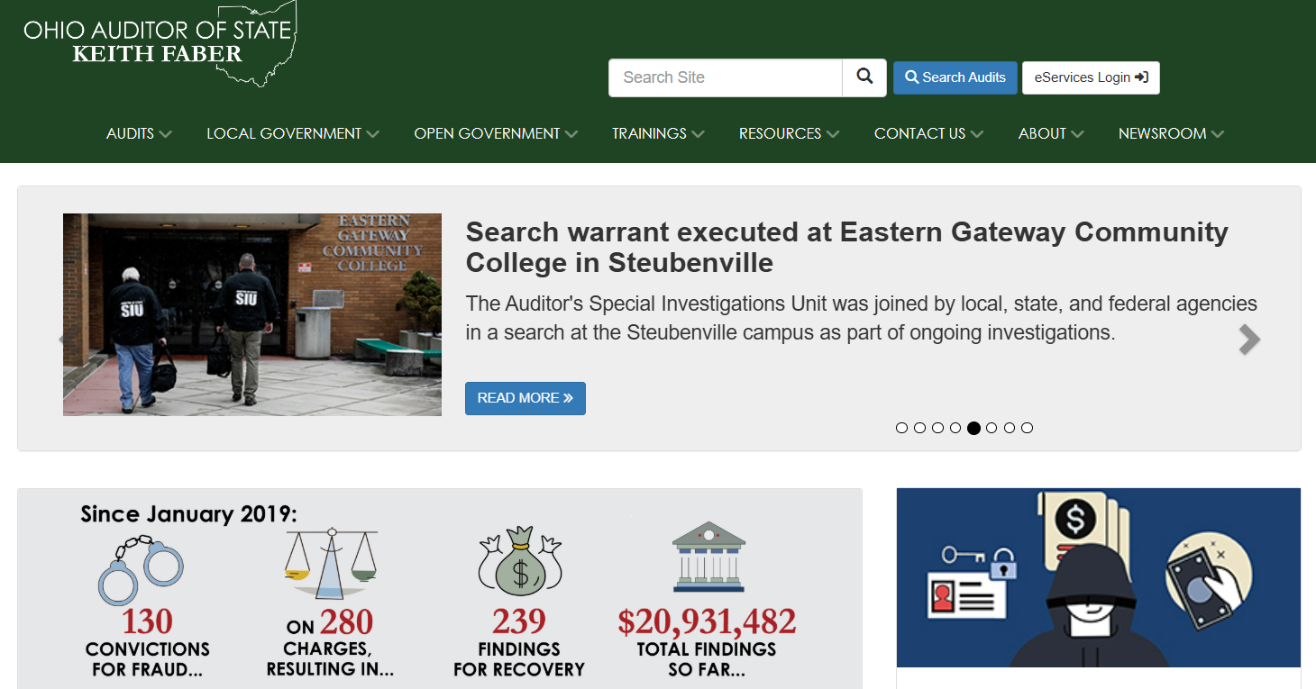
www.ohioauditor.gov
Notes:
The pages we will go to can be found under these different drop-down headers.

Slide 52
Resources on AOS Webpage
Audits
Local Government
Search Audits Released
ORC 9.24 Certified Finding for Recovery Search
New Fiscal Officer Resources
Reference Materials – OCS, Financial Statement & Footnote Shells, Single Audit Practice Aids, FACCR’s, AUP’s, ORC/OAC, Publications & Manuals (Checklist for an Outgoing FO, Handbooks, Manuals, Best Practices, Bulletins, Advisory Memos, etc.), Responsibilities of Those Charged with Governance
Hinkle System
UAN
Notes:
Following are some of the pages I will take you through…….

Slide 53
Resources on AOS Webpage
Trainings
Resources
MANY free webinars!
Federal
Registration for AOS conferences
eServices
Ohio Checkbook
Notes:
Certain items can be accessed by more than 1 header. For example, many of the items under the ‘Resources’ heading were already covered under the Local Gov. heading, and then in the reference materials section. I have included additional items under ‘resources’ here.

Slide 54
Resources on AOS Webpage
Contact Us
Newsroom
Report Fraud
Unauditable List
Request a Speaker
Notes:
Many of the items under the ‘Newsroom’ heading were already covered under other sections. 1 additional item is…..
At end – also point out ‘search site’ button at top.

Slide 55
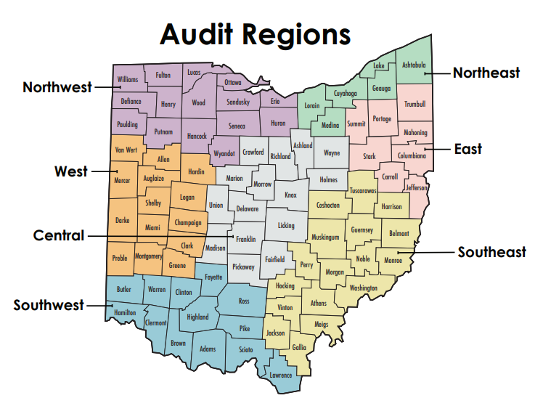
AOS Regional Office Numbers
Central 800-443-9275
East 800-443-9272
Northeast 800-626-2297
Northwest 800-443-9276
Southeast 800-441-1389
Southwest 800-368-7419
West 800-443-9274
Notes:
.AOS regional office phone #’s
So now……..how do you feel about your audit?

Slide 56
Ashley Perry
arperry@ohioauditor.gov

