Slide 1

OHIO GFOA
ADVANCED GOVERNMENTAL ACCOUNTING AND FINANCIAL REPORTING
August 6 & 7, 2025
Put-In-Bay, Ohio

Slide 2
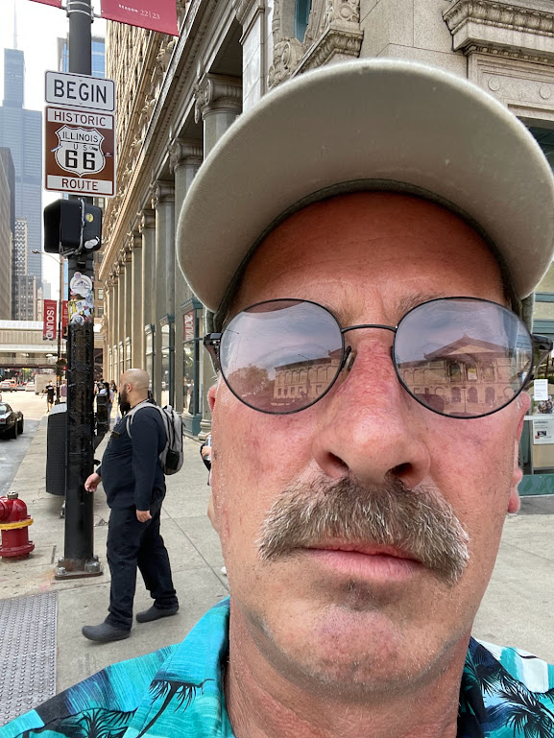
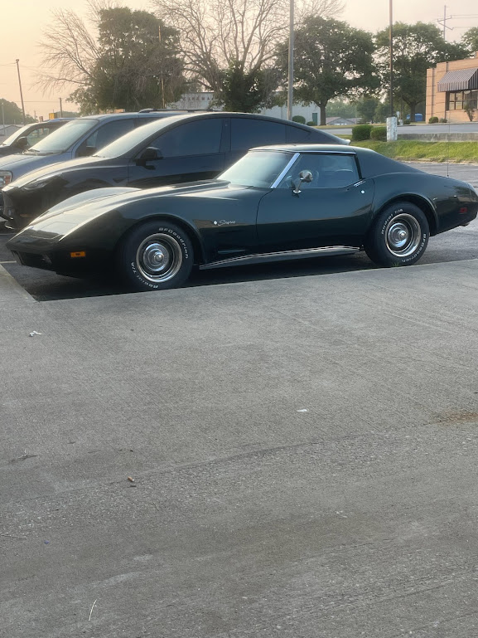
Introductions

Slide 3
Instructors
Jared Cottrell, Principal, Rea & Associates
Ashley Perry, Auditor of State of Ohio
Joann Bury, Director of Finance, City of Gahanna
Jeff McCuen, Ohio GFOA Education Chair

Slide 4
Introductions
Participants
  Name
  Title/Area of Work
  Entity
  Years of Experience
  One Interesting Fact??
  Complete index card(s) with questions

Slide 5
Course Objectives
Learn what’s new in governmental accounting
Ohio Legislative Activity
How to implement new GASB’s
Deep Dive Topics
Review outstanding GASB Projects

Slide 6
What’s going on?
GASB insatiable desire for more standards?

Slide 7
GFOA V. GASB
(per Jeffrey L. Esser, GFOA Executive Director/CEO)
GFOA concerned that GASB has been moving beyond its proper jurisdiction confusing accounting with accountability
GASB insists that its charge extends not just to accounting, but to all aspects of accountability – staking a claim to set future reporting standards for future financial and non financial aspects of public administration

Slide 8
GFOA Concerns
GASB has opted for a supply driven approach, which presumes demand for standards is limitless
  14 standards in 1992 NOW #104!!!!
There isn’t an accounting solution to every financial problem
GASB has been creating unnecessary divergence from private-sector standards
  Exemplified by separate standard for factoring receivables, pollution remediation, deferred inflows & outflows and derivatives

Slide 9
Prospects for the future
GFOA remains committed to independent standard setting
GFOA Survey of financial reporting
GFOA will carefully monitor developments and represent interests of state and local governments

Slide 10
GASB Projects Process
Pre-Agenda Research
Add to Agenda
Deliberations
Invitation to Comment
Preliminary Views
  Comment period & redeliberate
Exposure Draft
  Comment period & redeliberate
Final Pronouncement

Slide 11
GASB Projects Process
“The users are often very late to the game in terms of understanding the impact of new accounting standards”
~ Mark LaMonte, former managing director Moody’s Investors Service
Many opportunities to provide input
We need to do a better job of getting out front of these issues.

Slide 12
GASB Year in Review
Overview of Upcoming Implementations
New Pronouncements - 2
Exposure Drafts

Slide 13
When do we Implement?
Statement #
Effective for Periods beginning after:
GASB 103 Financial Reporting Model Improvements
GASB 104 Disclosure of Certain Capital Assets
June 15, 2025
June 15, 2025

Slide 14
Current GASB Projects
Going Concern Uncertainties and Severe
Financial Distress
  Comment period ended 6/25/25
Infrastructure Assets
  Exposure Draft coming

Slide 15
Current GASB Projects
Revenue and Expense Recognition
  Exposure Draft coming
Subsequent Events
  Redeliberation

Slide 16

Worthington AM Rotary
OSU Football Raffle
1 chance for $20
3 chances for $50
wamr.org/footballraffle

